Slide 1




2
Power BI
Manager Guide
Prepared By :
Said Fawzy
Manager of Information Center
Tendering Department
Arab Contractors

Slide 2

Chapter 2: Preparing Data For Analysis

Slide 3
01
What is Data?
02
People Working in Data
Module Contents
Connecting to Data Sources
03
Transforming Data
04

Slide 4
05
Power Query
06
Common Data Errors
Module Contents
Data Combination
07
Data Profiling
08

Slide 5

ETL Process

Slide 6
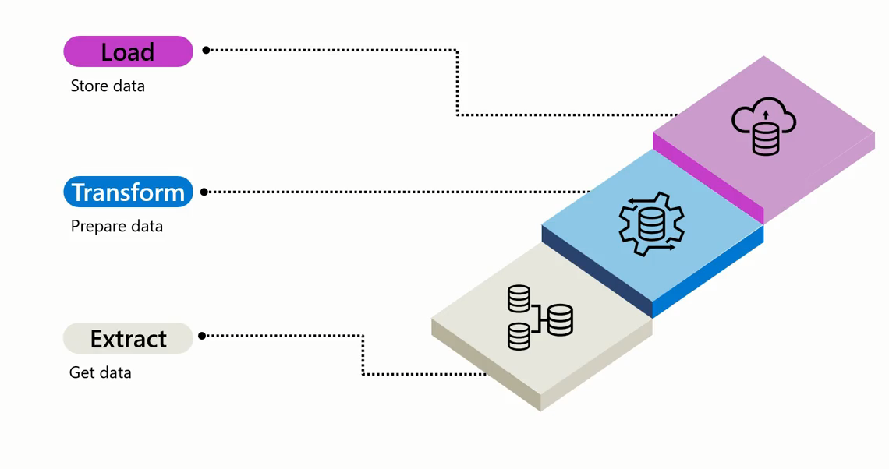
ETL Process

Slide 7

ETL Process

Slide 8




Extract Process

Slide 9

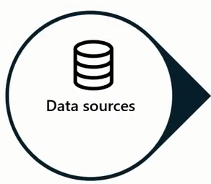
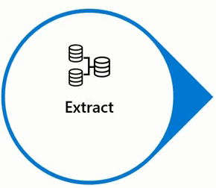


Extract Process

Slide 10


Slide 11
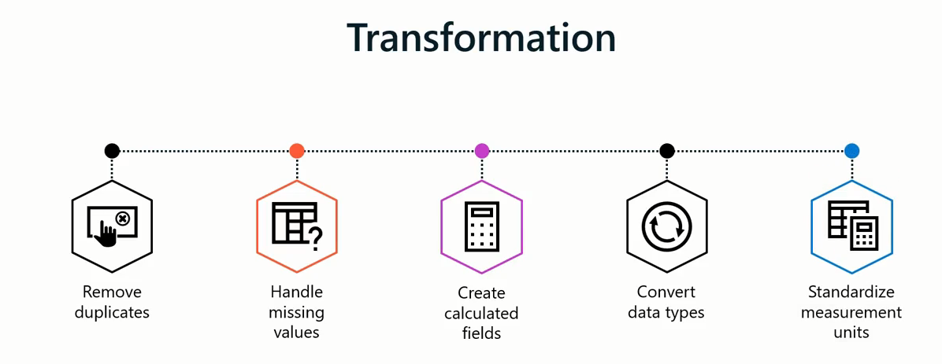
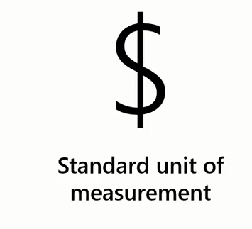
Transform Process

Slide 12


Slide 13

Load Process

Slide 14
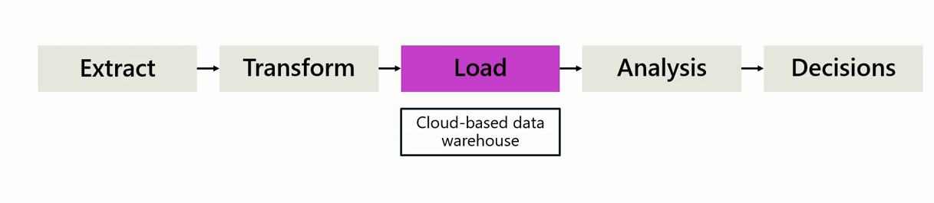
ETL Process

Slide 15

ETL Process

Slide 16

ETL Process

Slide 17
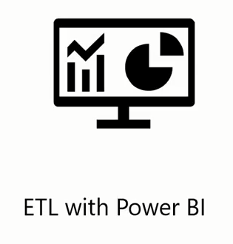
ETL Process

Slide 18
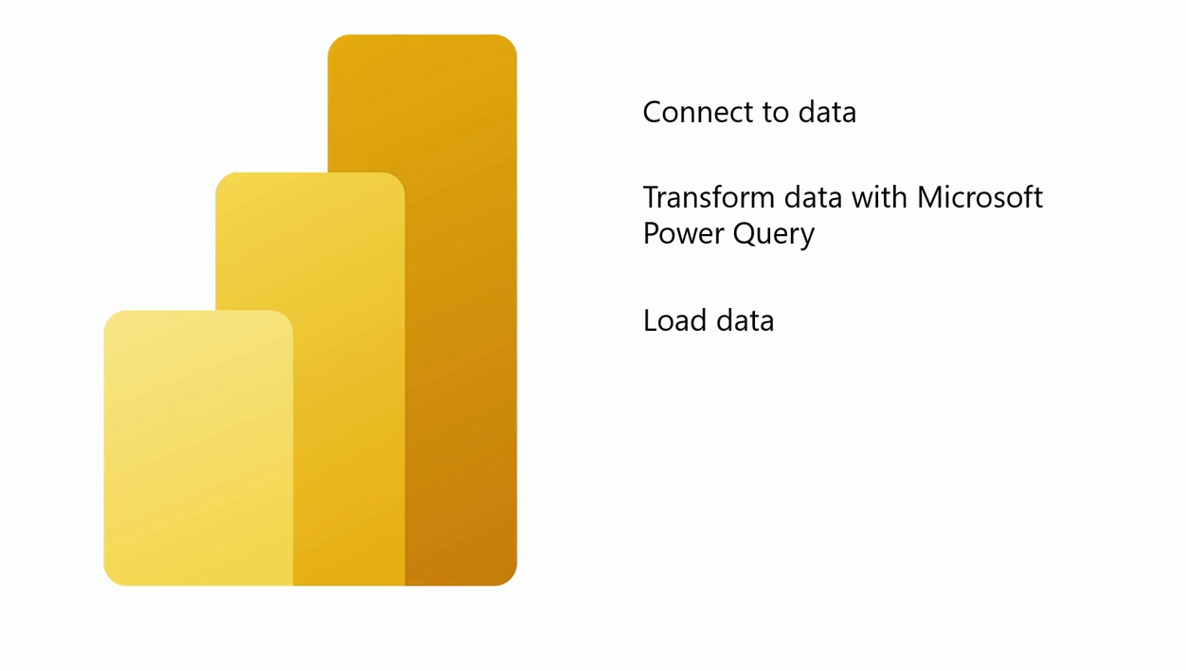
ETL With Power BI

Slide 19
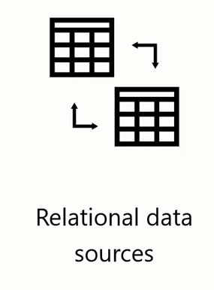
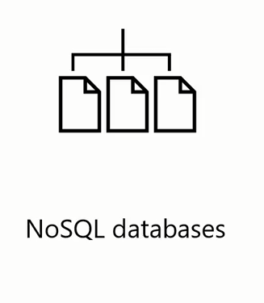

Data Sources You can Connect in Power BI

Slide 20
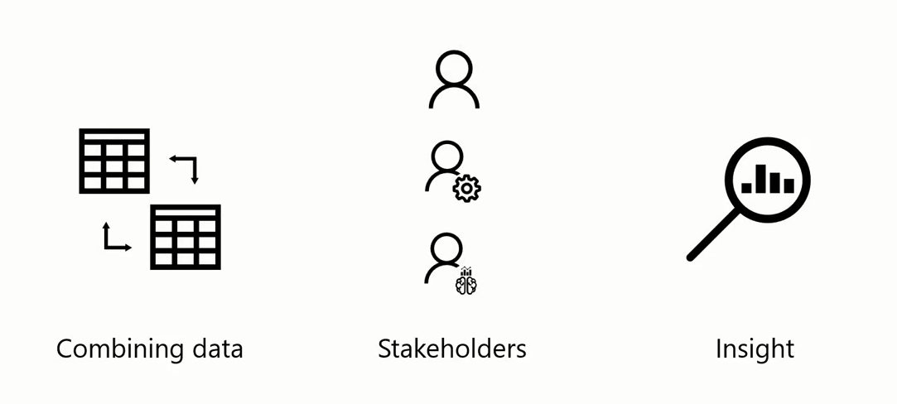
Combining Data Sources benefits

Slide 21

Combining Data Sources benefits

Slide 22

Combining Data Sources benefits

Slide 23
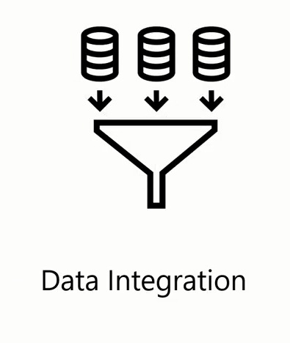

Combining Data Sources benefits

Slide 24

Combining Data Sources benefits

Slide 25

Combining Data Sources benefits

Slide 26
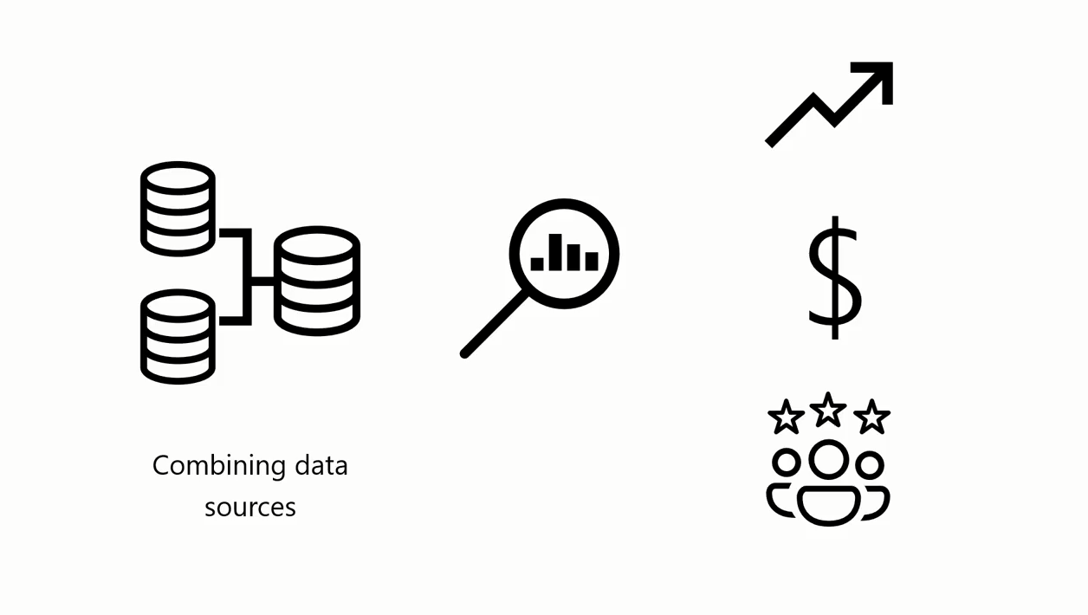
Combining Data Sources benefits

Slide 27

What is a Flat File?
A flat file is a file type that contains a single data table, with a uniform structure for every row of data, and does not have hierarchies.

Slide 28
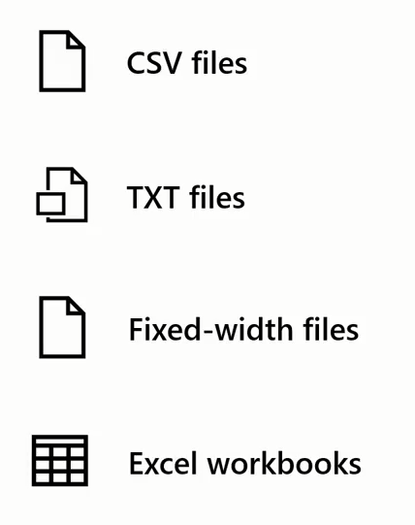
Examples of Flat Files

Slide 29
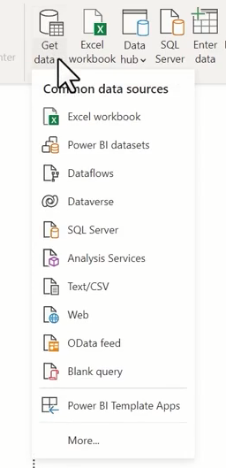
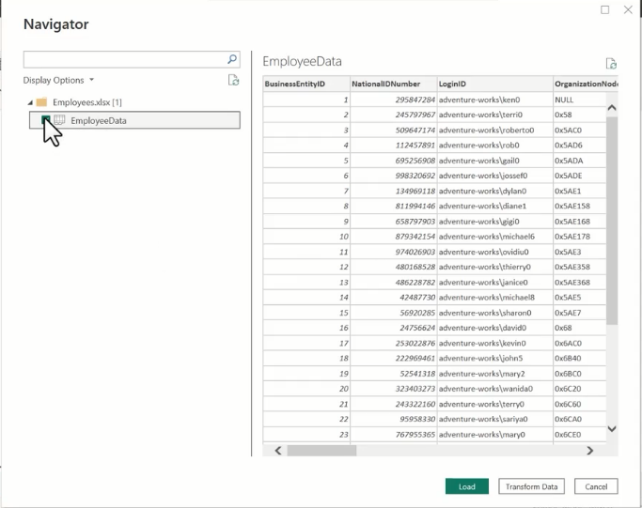
Set up a Flat Data source

Slide 30

Why data needs to be transformed

Slide 31
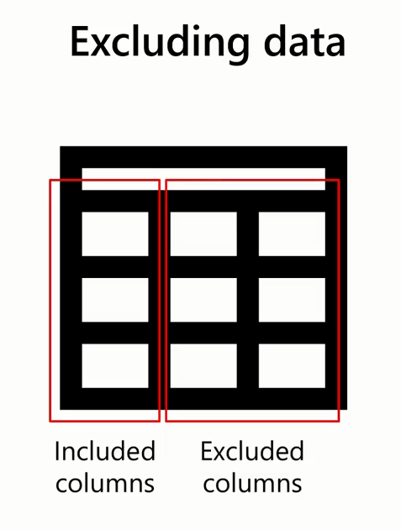
Some Iconicity You Might Find in Data

Slide 32
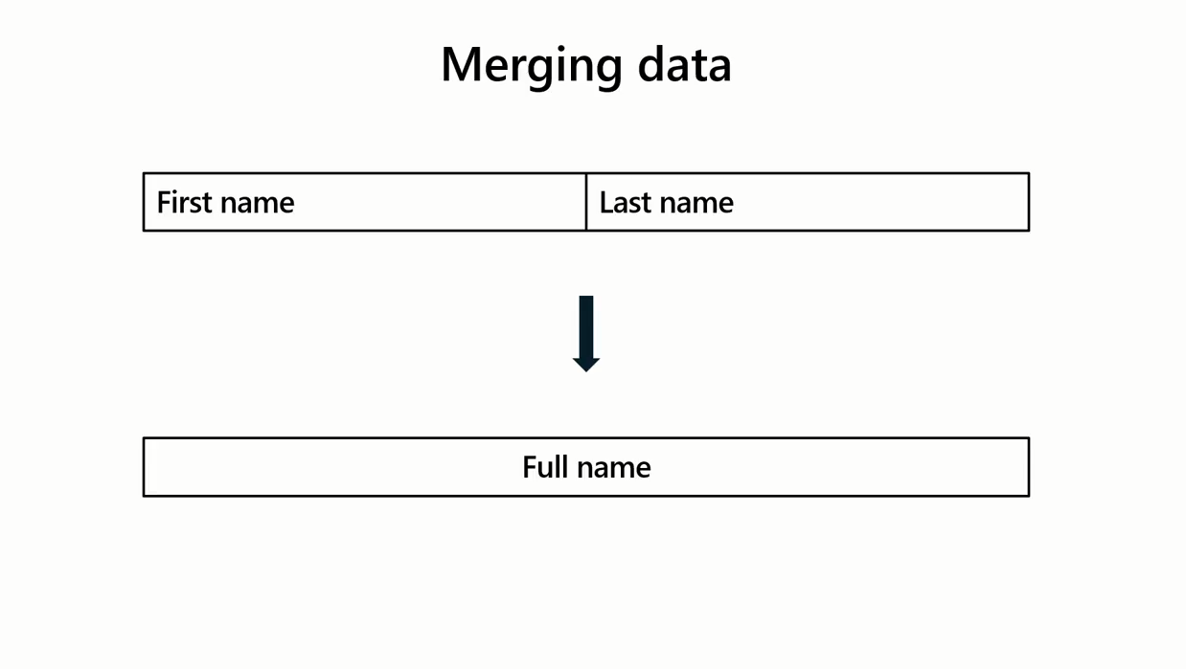

Slide 33


Slide 34
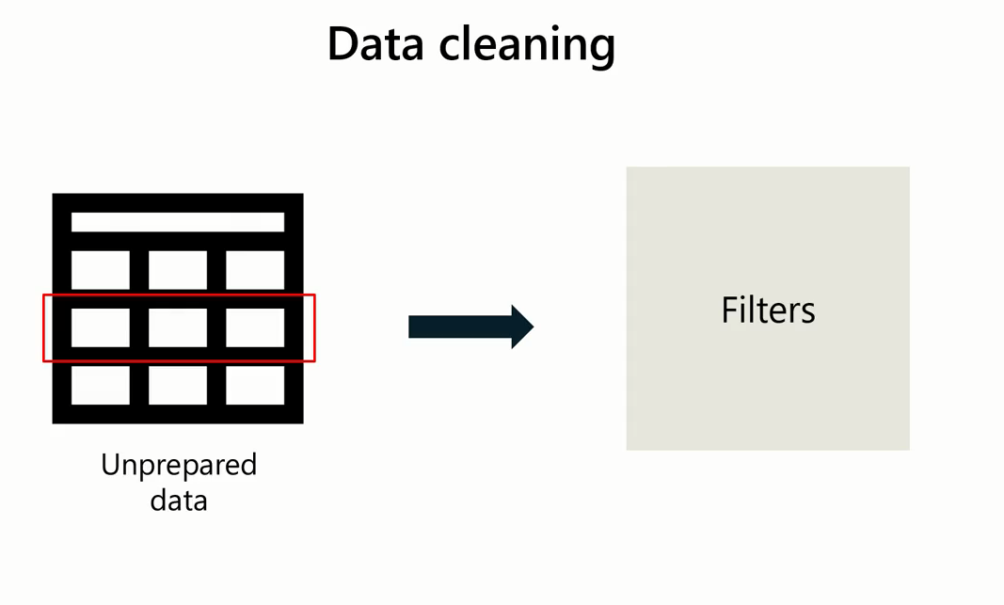

Slide 35








Slide 36


Slide 37
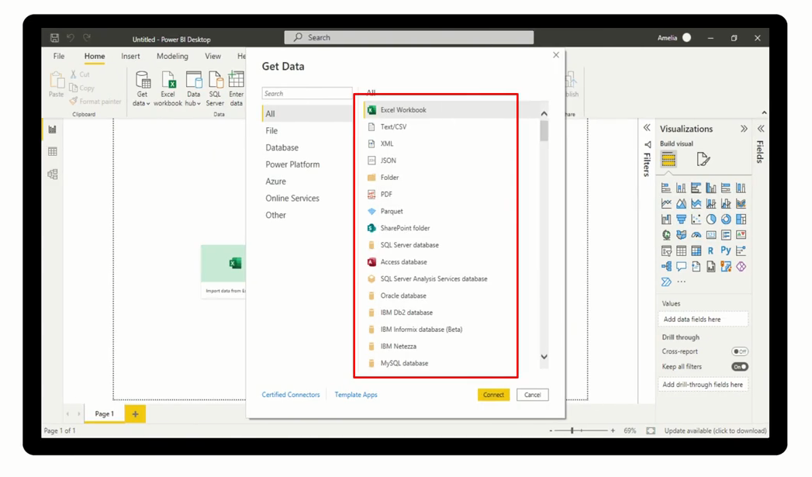

Features that Power Query can help with

Slide 38
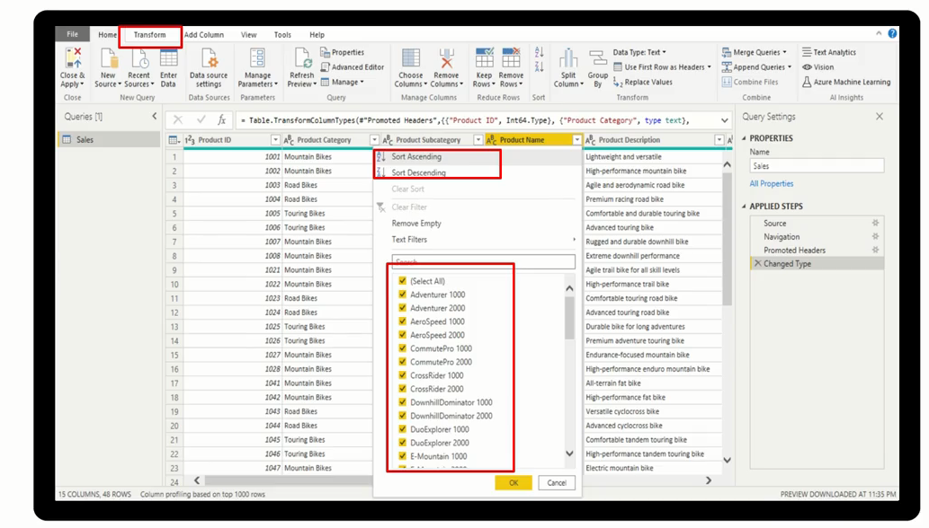

Features that Power Query can help with

Slide 39
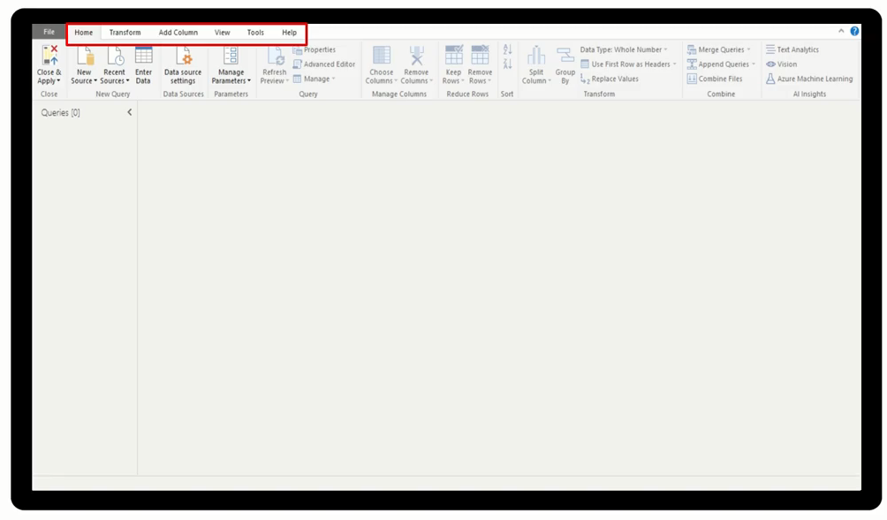

Features that Power Query can help with

Slide 40
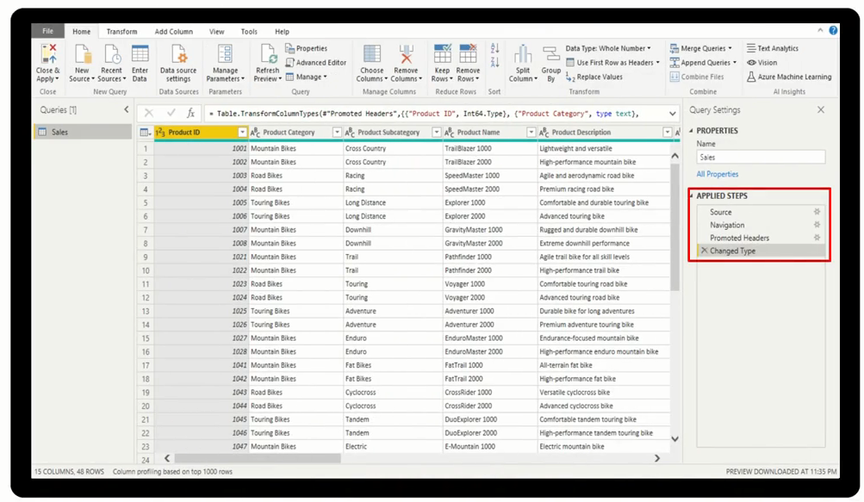

Features that Power Query can help with

Slide 41
Explore Power Query
Ribbon

Slide 42
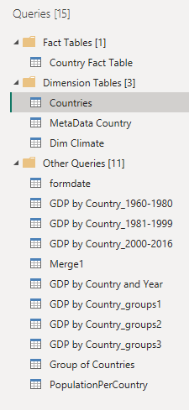
Explore Power Query
Queries Pane

Slide 43
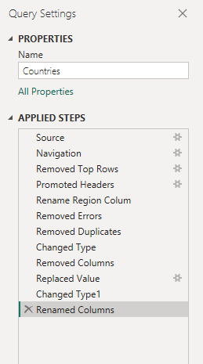
Explore Power Query
Applied Steps

Slide 44
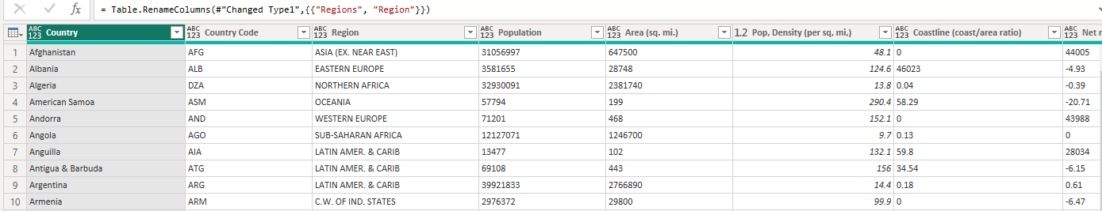
Explore Power Query
Data Preview

Slide 45
Data Types
Number types
Decimal number
Fixed decimal number
Whole number:

Slide 46
Data Types
Date and Time types
Date/time:
Date:
Time:
Date/time/timezone:.
Duration:

Slide 47
Data Types
Other data types
Text
True/false: This is also known as Boolean data type,
Binary:.

Slide 48



Benefits of working with Columns

Slide 49
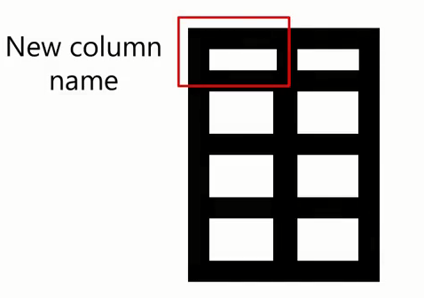



Benefits of working with Columns

Slide 50



Benefits of working with Columns

Slide 51




Benefits of working with Columns

Slide 52


Benefits of working with Columns
Reduce Computational Resources

Slide 53

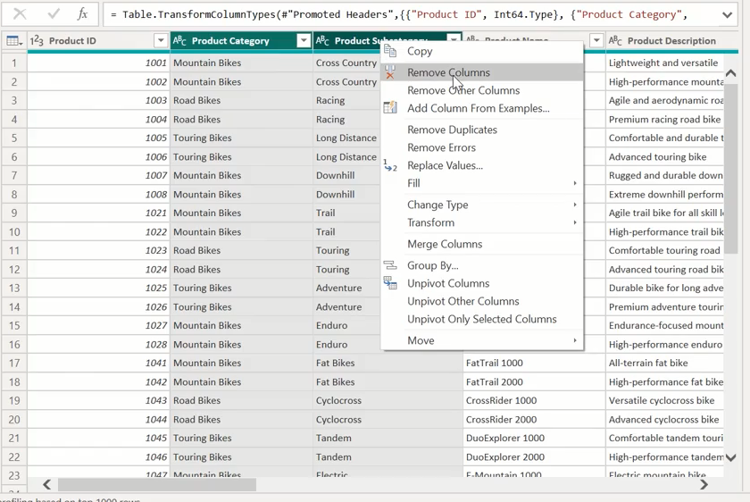
Remove Columns

Slide 54
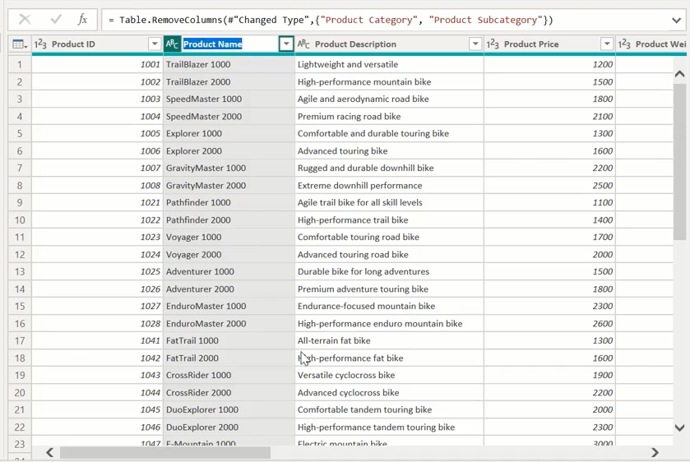
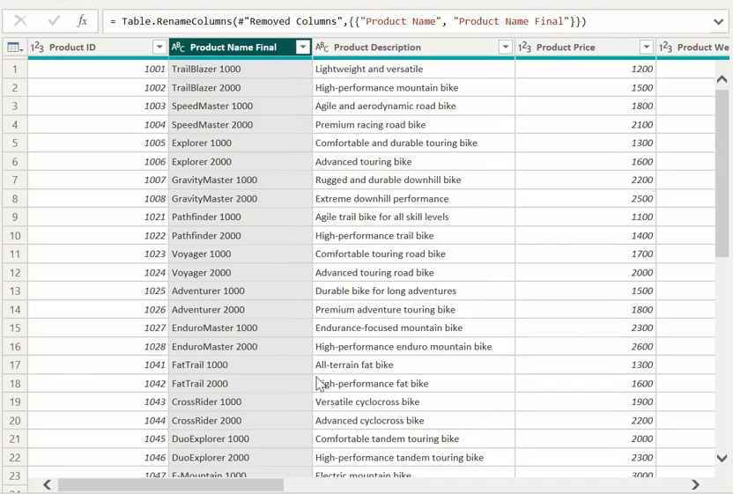
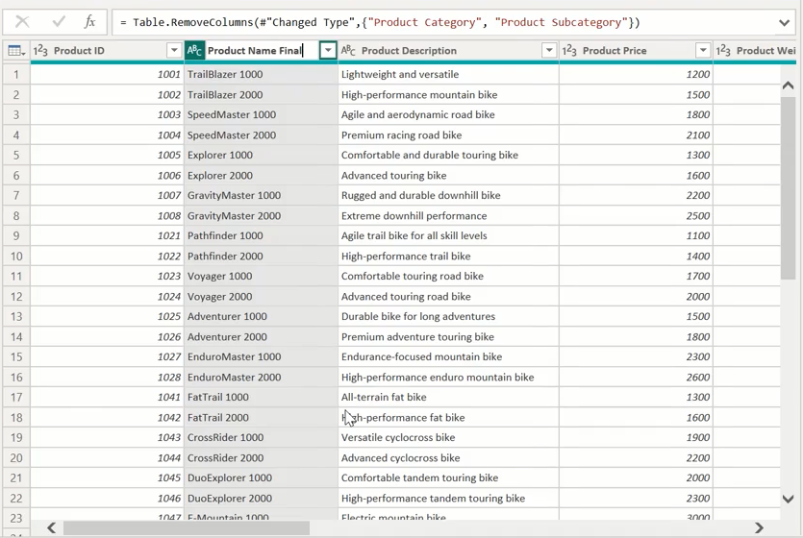
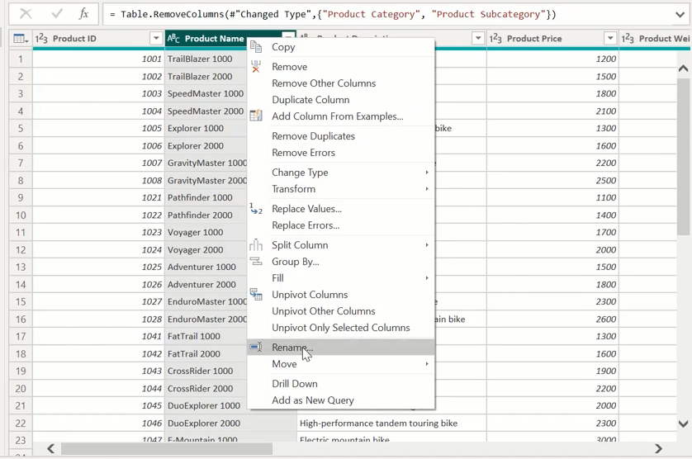
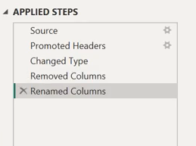
Rename Columns

Slide 55
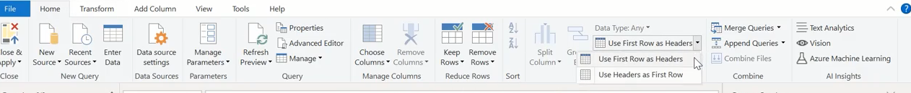
Promote Header Rows

Slide 56
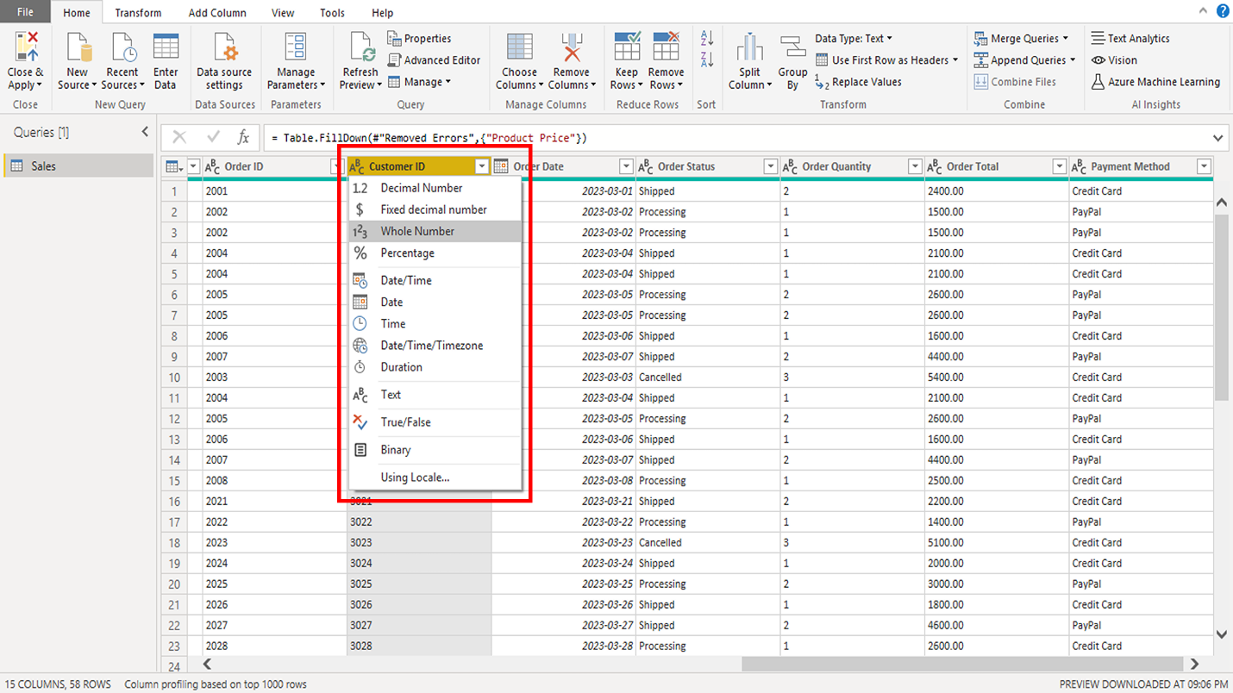
Change a data type

Slide 57
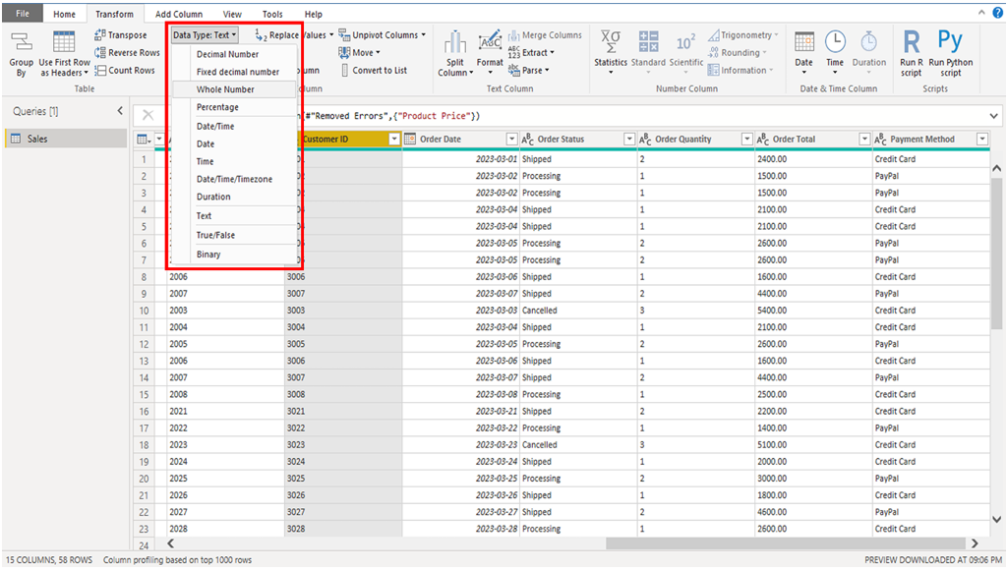
Change a data type

Slide 58
Common errors
Missing or null values
Duplicate rows
Inconsistent data types.

Slide 59
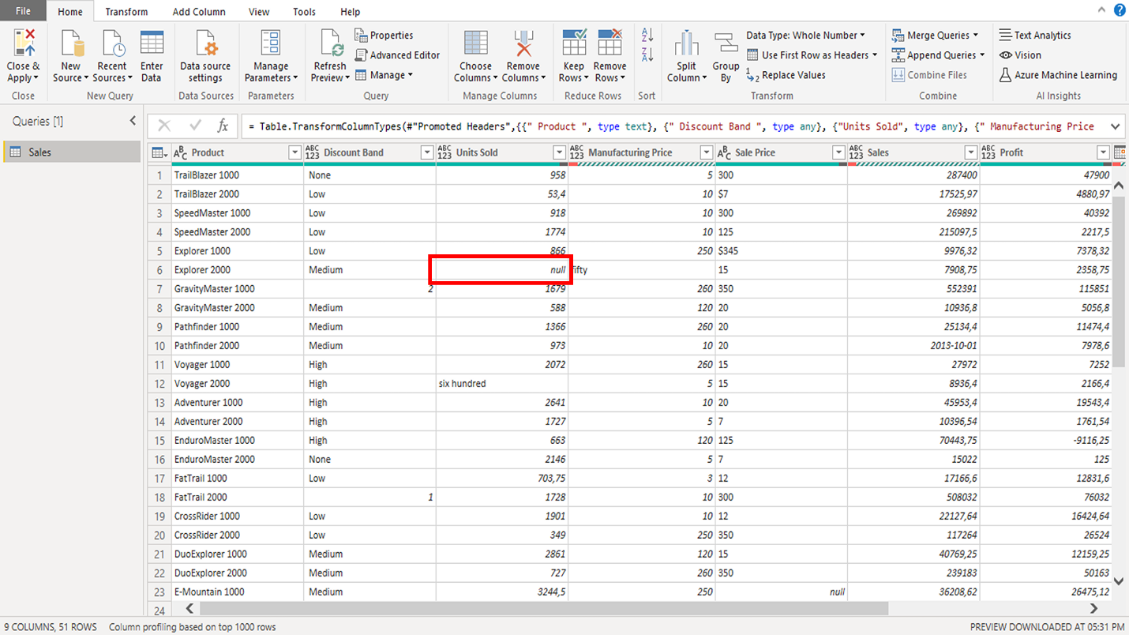
Missing or null values

Slide 60
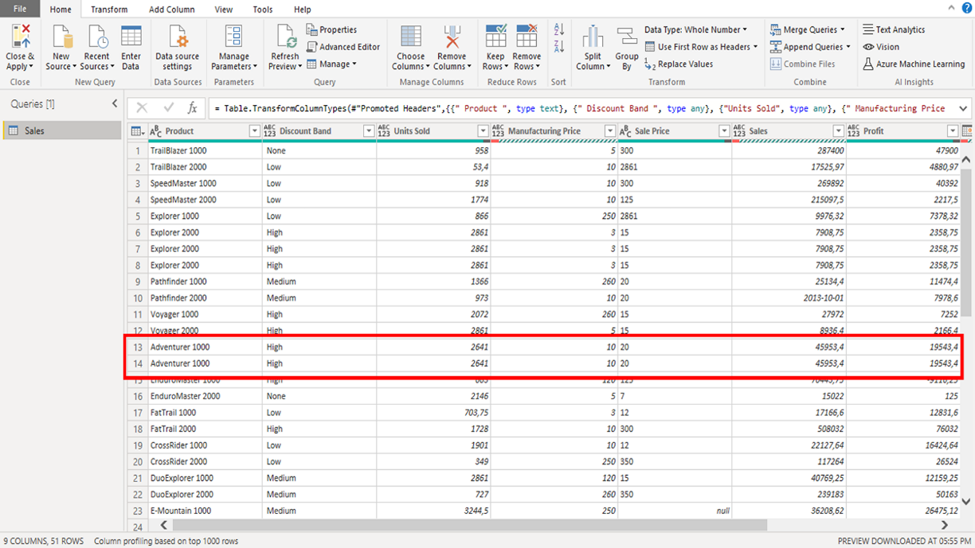
Duplicate rows

Slide 61
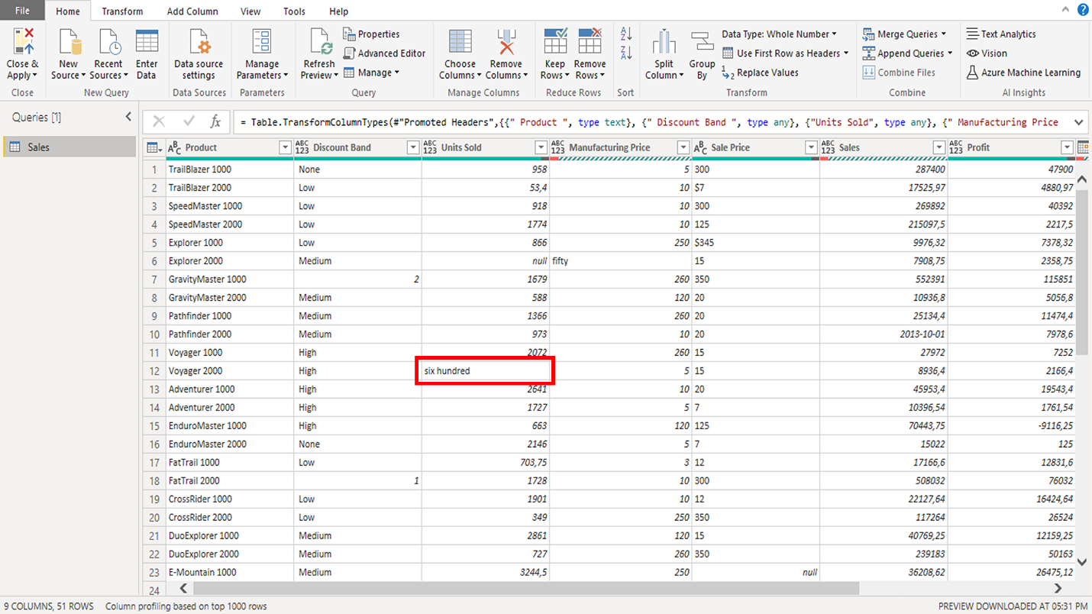
Inconsistent data types

Slide 62
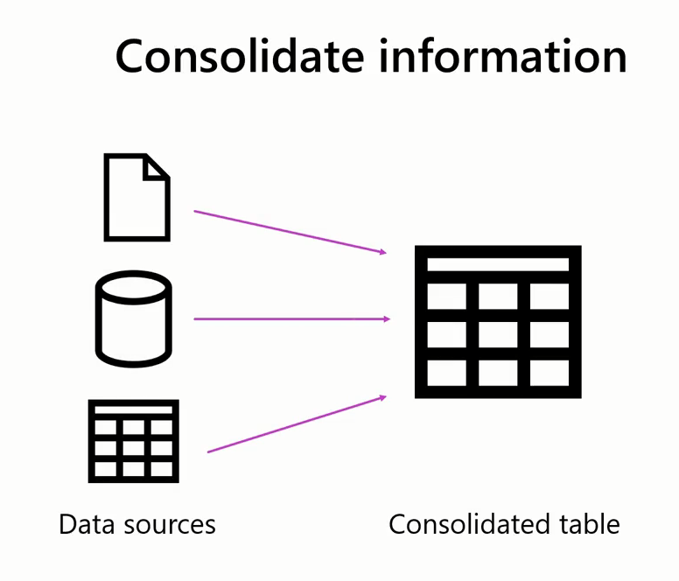
The Importance of data combination

Slide 63




The Importance of data combination

Slide 64
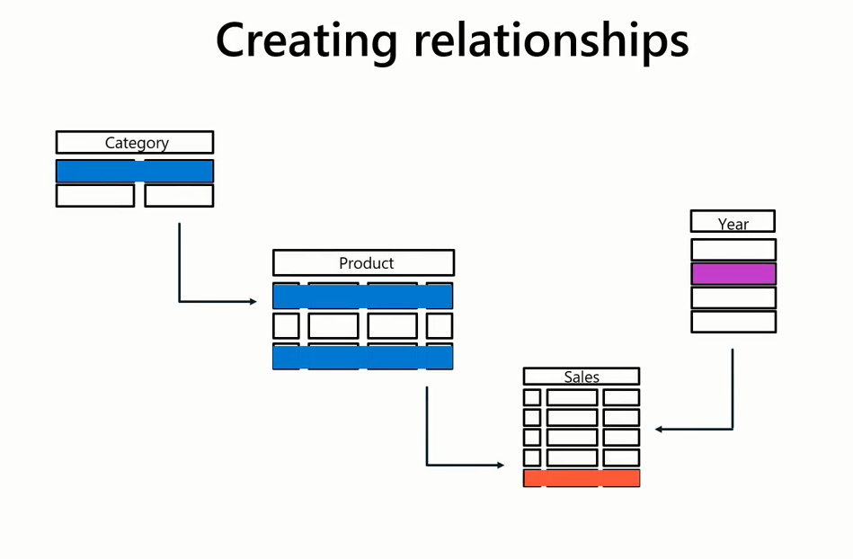
The Importance of data combination

Slide 65


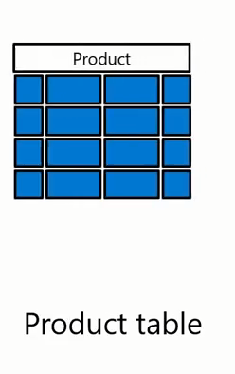
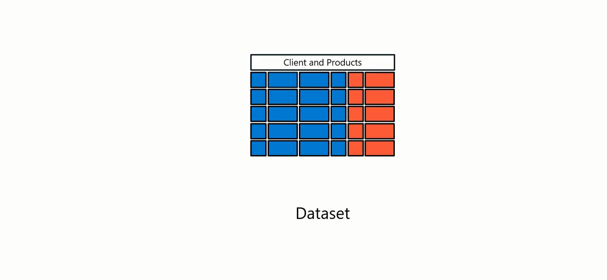
The Importance of data combination

Slide 66
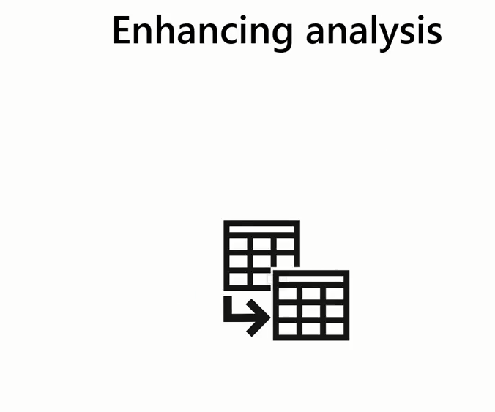

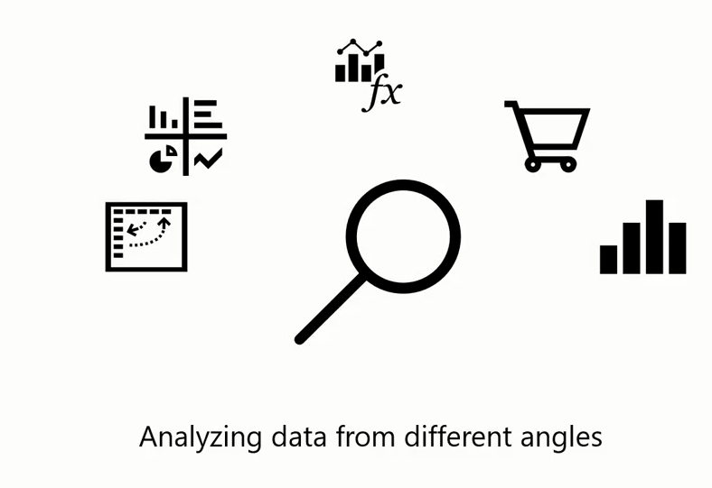
The Importance of data combination

Slide 67







The Importance of data combination

Slide 68


Two Ways to Combine Data

Slide 69
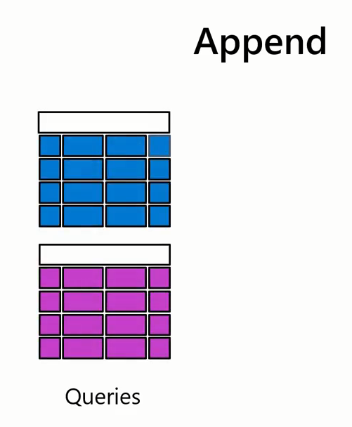

Two Ways to Combine Data

Slide 70


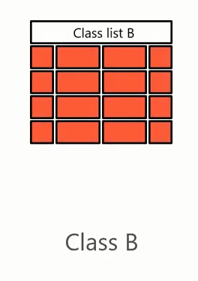

Two Ways to Combine Data

Slide 71



Two Ways to Combine Data

Slide 72
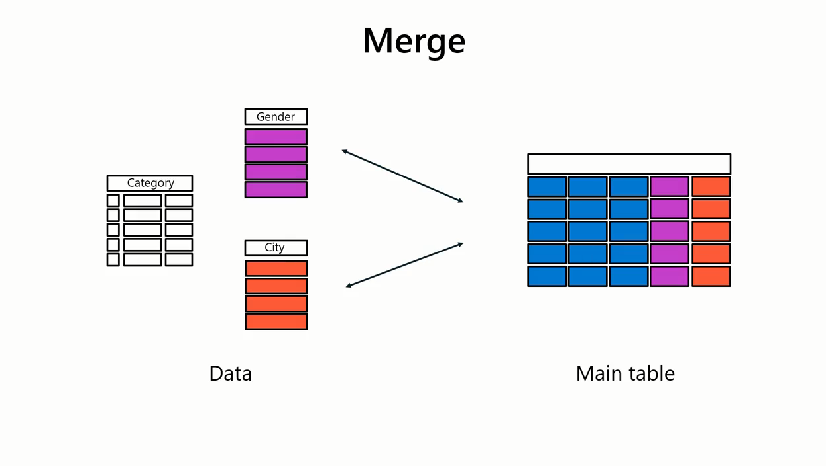
Two Ways to Combine Data

Slide 73

Unpivot and pivot operations are data transformation techniques that you can use to reshape and restructure data

Slide 74

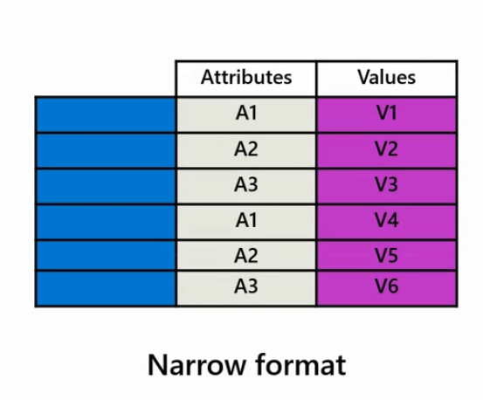
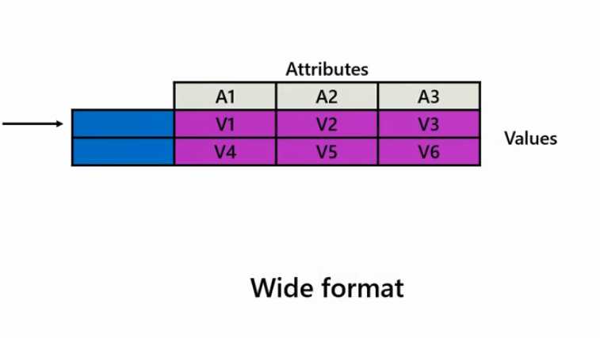
the pivot operation refers to the transformation of data from a narrow format with fewer columns to a wide format with multiple columns by reorganizing the data structure

Slide 75

It enables data analysts to convert rows into columns based on specific criteria or values

Slide 76

This operation is often used to summarize and aggregate data, create cross-tabulations, and represent data in a more structured easy-to-understand way for analysis and reporting

Slide 77

Example
say you want to analyze the sales data based on different product categories as part of the sales analysis

Slide 78

you can transform the rows containing individual product categories into separate columns.

Slide 79

This pivot operation enables you to present the sales data in a more concise and structured manner, making it easier to identify trends, top-selling products, and performance within each category

Slide 80

The unpivot operation refers to the transformation of data from a wide format with multiple columns to a narrow format with fewer columns by reshaping the data structure

Slide 81

It involves converting column headers into row values resulting in a more structured and standardized representation of the data

Slide 82

Data Profiling

Slide 83

Data Profiling
You should check these characteristics for each numerical field

Slide 84

Data Profiling
Example

Slide 85

Data Profiling
Example

Slide 86


Data Profiling
Min , Max
Example

Slide 87

Data Profiling

Slide 88

Outlier
A data point that significantly deviates from other observations.
Min-Max Scaling

Slide 89



Slide 90



Slide 91

Outliers

Slide 92


Slide 93


Slide 94


Slide 95


Slide 96
Profiling Tools in Power Query
Microsoft power BI offers the following two profiling tools in the Power Query editor:
column quality, and
column distribution.

Slide 97



Slide 98


Slide 99


Slide 100


Slide 101


Slide 102


Slide 103



Example

Slide 104


Slide 105



Slide 106




Slide 107

If all the row values are distinct, then unique and distinct amounts will be equal

Slide 108



Slide 109


Power Query performs data profiling on the initial 1,000 rows of your data.

Slide 110


